Slide 1
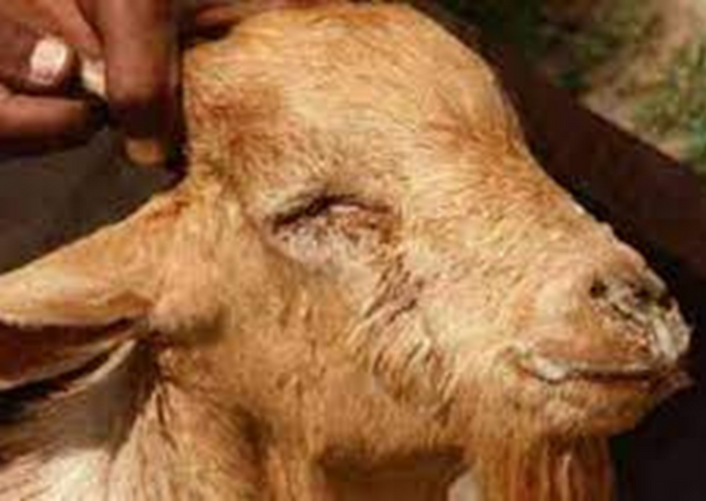
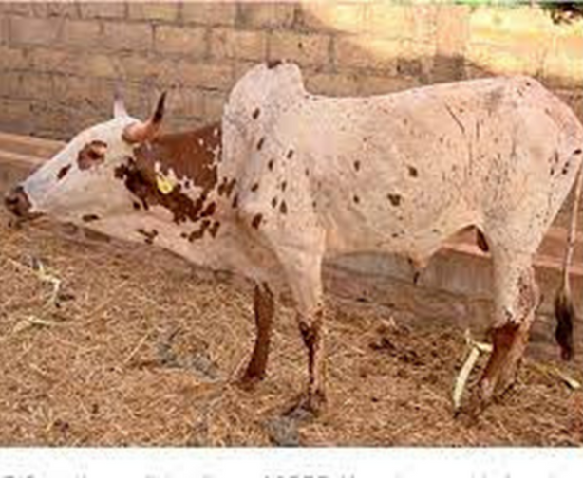
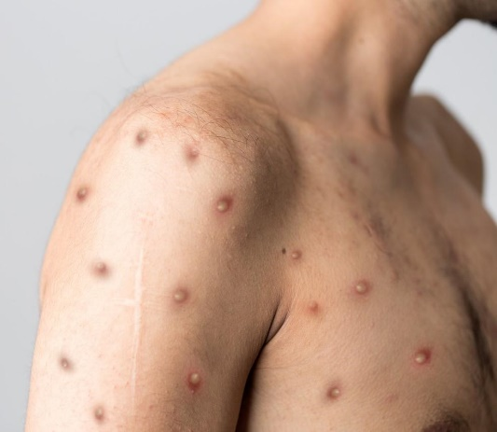
Basic Concepts of Disease Identification and its Relevance to One Health
Mahmud Saulawa

Slide 2
OUTLINE
Introduction
Impact of Livestock Diseases
Pattern of Disease Occurrence
TADs
Zoonotic Diseases
Abattoir and One Health
Disease Transmission Routes
Disease Identification (Poultry, Ruminant)
Viral, Bacterial & Metabolic Diseases
Livestock Biosecurity

Slide 3

INTRODUCTION
Nigeria boasts of a livestock population of over 395 Million including ruminant livestock (Cattle-21.2 million, Sheep-48.6 million, and Goats-76.3 million) and 249 million heads of poultry.
1/3 of households in Nigeria are engaged in small-scale livestock production, contributing significantly to the market worth #30 trillion.
The FAO predicts that by 2030, livestock production will surge, with an estimated increase of 159% for small ruminants and 266% for poultry, driven by the escalating demand for animal-source protein.
However, livestock productivity in Nigeria is threatened by livestock diseases.

Slide 4




IMPACT OF LIVESTOCK DISEASES
  Reduce productivity (Milk, egg, weight)
  Mortality
  Reduced income and profitability
  Increase cost of medication & veterinary interventions
EFFECT ON PRODUCTION
  Trade restrictions
  Reduce contribution to GDP
  Decreased IGR
  Loss of Jobs and livelihood
NATIONAL ECONOMY
  Increase risk of Zoonotic disease transmission
  Increase risk of AMR
  Malnutrition
PUBLIC HEALTH

Slide 5
PATTERN OF DISEASE OCCURENCE
The way diseases appears, spread and persist in populations over time and space, then the disease occurs in the following patterns:
  Sporadic
  Endemic
  Epidemic
  Pandemic

Slide 6


Sporadic: When a disease appears only rarely, irregularly or infrequently in individuals of a given population and in scattered cases i.e Anthrax, Rabies
Endemic: Disease which is constantly present in a particular population or area at a predictable level i.e Trypanosomiasis in Sub-Saharan Africa, malaria parasite, Salmonellosis (Fowl Typhoid, Typhoid Fever), HIV

Slide 7

Epidemic:
Sudden increase in the number of cases of a disease above the expected level in a population i.e Cholera, measles, influenza
Pandemic:
An epidemic that has spread over several countries or continents, usually affecting a large population i.e Ebola, SARS, Covid-19, HPAI

Slide 8
Transboundary Animal Diseases (TADs)
Are highly contagious and transmissible, epidemic diseases with the potential to spread rapidly across national boarders and affect other countries.
They have the potential to cause significant economic losses and public health consequences.
TADs pose a great threat to the livelihoods of livestock farmers, animal welfare and the food security esp. International trades.

Slide 9



EXAMPLES OF TADs
  Newcastle Disease (NCD)
  Peste des Petits Ruminants (PPR)
  Foot and Mouth Disease (FMD)
  African Swine Fever (ASF)
  Contagious Bovine Pleuropneumonia (CBPP)
  Anthrax

Slide 10

What are Zoonoses?
Communicable/infectious diseases.
Shared between human and animal populations.
75% of emerging infectious diseases of humans are from animal origin.
Zoonotic outbreaks occur when these diseases spread among human populations in increasing numbers.

Slide 11
Examples of such deadly diseases includes:
Rabies
Corona Virus Disease-19 (COVID-19)
Lassa Fever
Avian Influenza (Bird Flu)
Ebola Virus Disease
Monkey Pox Virus

Slide 12
RISK FACTORS FOR ZOONOTIC DISEASE OUTBREAK
Increase in international travels.
Methods of husbandry management of food animals.
Destruction rate of natural habitats (Ecosystem).
Agricultural practices (i.e Poor biosecurity and AMR in livestock).
Wildlife trade and consumption.
Climate and seasonal changes (Temperature and humidity).
Socioeconomic and cultural factors (Poor sanitation etc).

Slide 13


Zoonotic diseases cause high economic impact and huge burden on public health.
The risk of zoonoses is high due to increasing interaction between humans and animals.

Slide 14
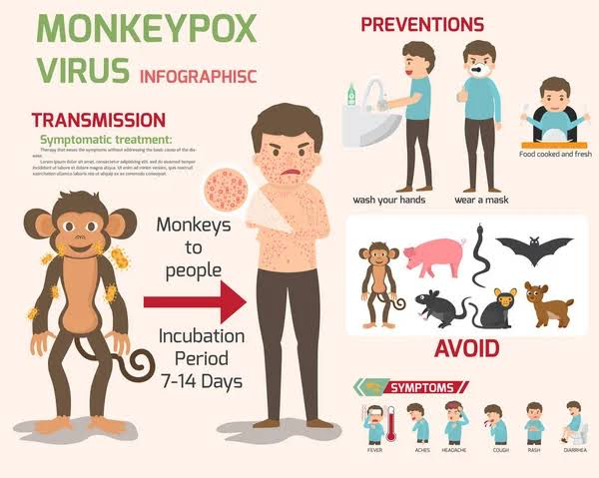

Slide 15
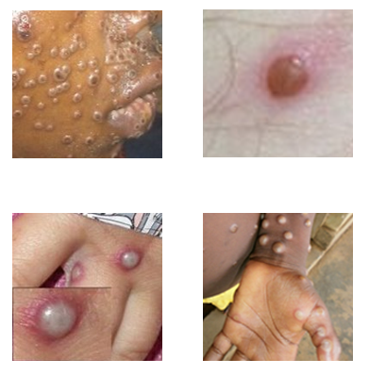
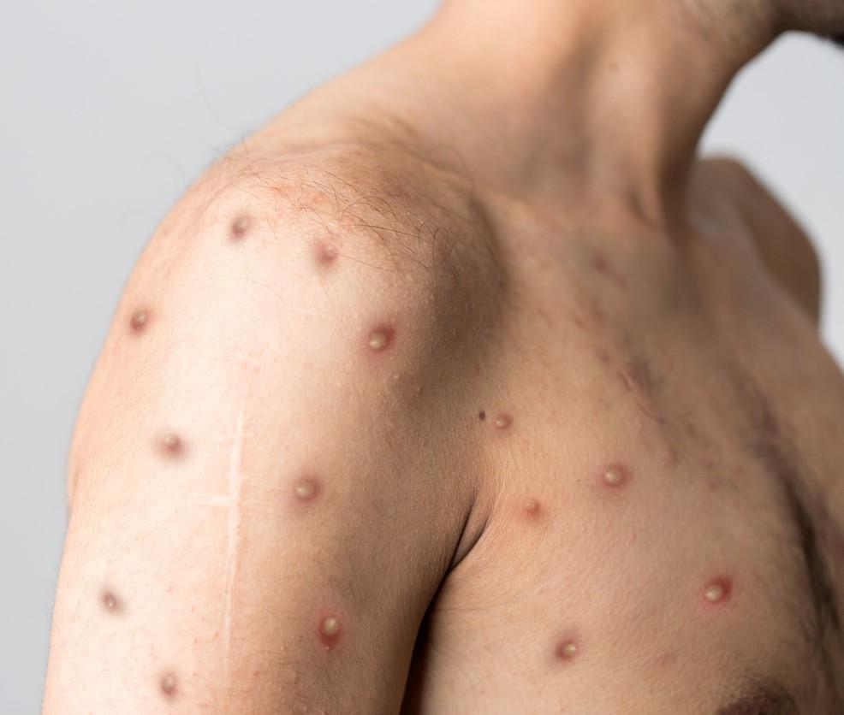
Typical Monkey pox lesions in humans

Slide 16
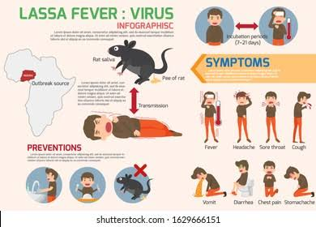

Slide 17
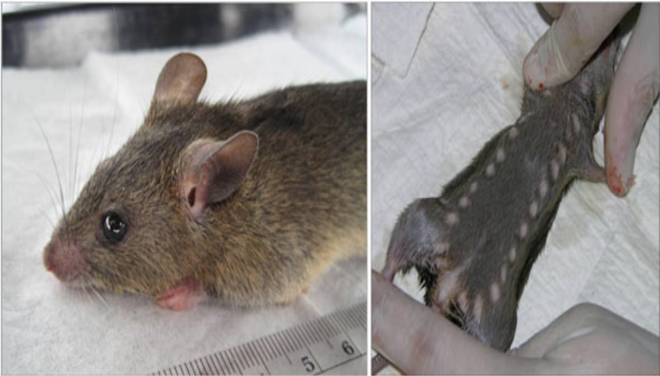
Multimammate Rat (Mastomys natalensis)

Slide 18
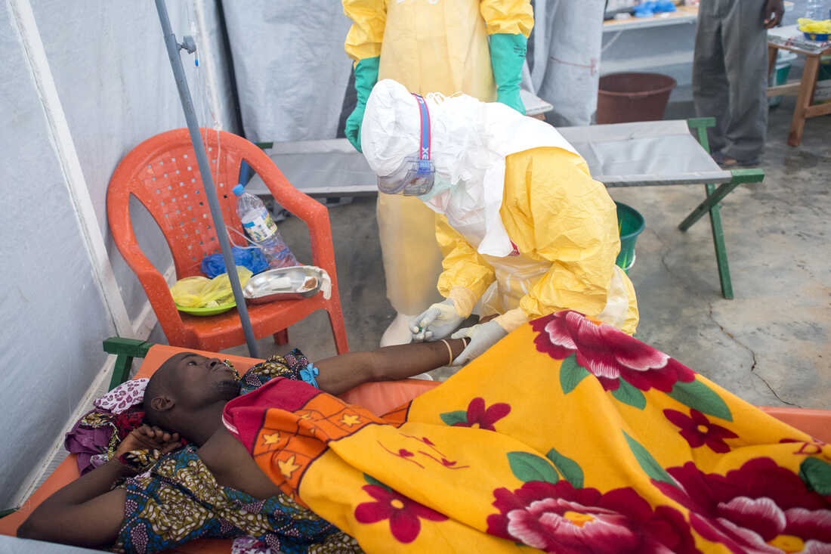
Lassa Fever Patient

Slide 19
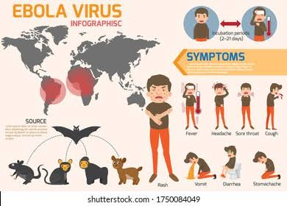

Slide 20
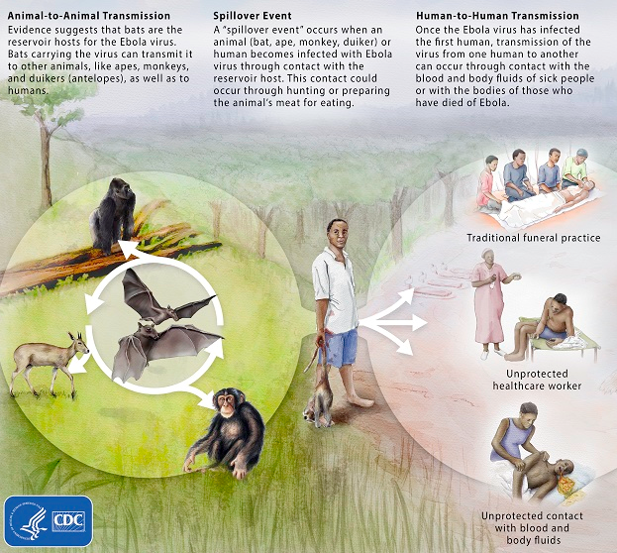
Ebola Virus
Zoonotic virus – bats are the most likely reservoir, although species unknown.
Spillover event from infected wild animals (e.g., fruit bats, monkey, duiker) to humans, followed by human-human transmission
20

Slide 21
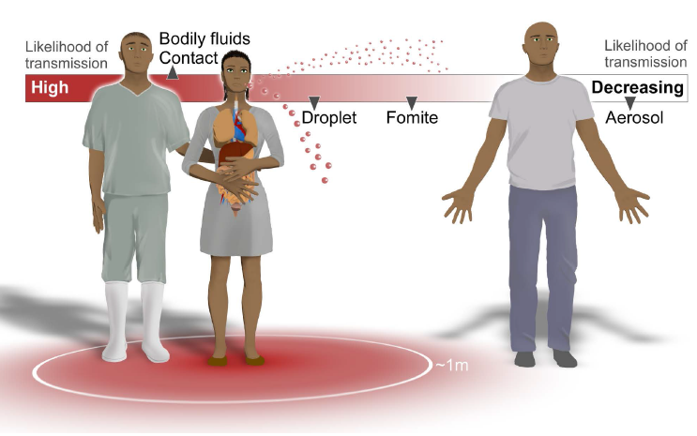
Ebola Virus Transmission
Direct contact with infected patients or cadavers
Mucosal surfaces, skin abrasions, parenteral introduction
Blood, vomit, excreta, genital and nasal secretions, sweat, urine

Slide 22
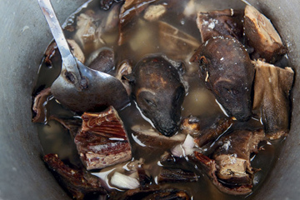
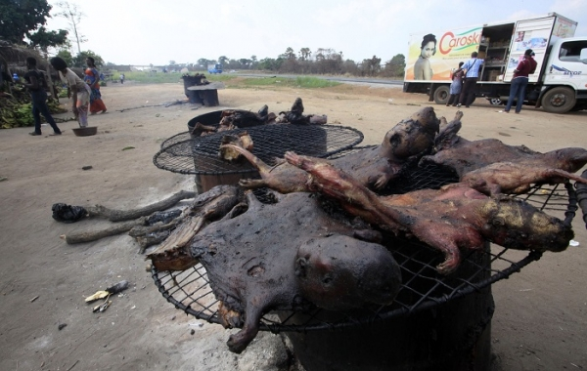
Ebola virus disease (EVD) outbreak in West Africa

Slide 23
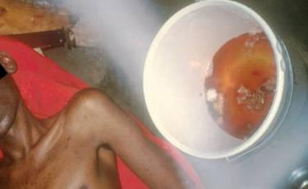
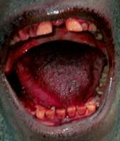
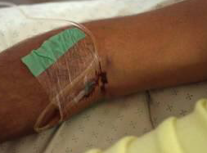
Clinical Signs of Ebola Haemorrhagic Fever
Hematemesis
Gingival bleeding
Bleeding at IV Site
23

Slide 24
Ebola Cases and Deaths
 | Reporting Date | Total Cases (Suspected, Probable, and Confirmed) | Confirmed Cases | Total Deaths
Guinea | 28 Dec 15 | 3,804 | 3,351 | 2,536
Sierra Leone² | 7 Feb 16 | 14,124 | 8,706 | 3,956
Liberia³ | 14 Jan 16 | 10675 | 3160 | 4809
Italy⁴ | 20 May 15 | 1 | 1 | 0
United Kingdom⁴ | 29 Dec 14 | 1 | 1 | 0
Nigeria⁴ | 15 Oct 14 | 20 | 19 | 8
Spain⁴ | 27 Oct 14 | 1 | 1 | 0
Senegal⁴ | 15 Oct 14 | 1 | 1 | 0
United States⁴ | 24 Oct 14 | 4 | 4 | 1
Mali⁴ | 23 Nov 14 | 8 | 7 | 6
TOTAL |  | 28,639 | 15,251 | 11,316
¹ Total cases include probable, suspected, and confirmed cases. Reported by WHO using data from ministries of health.
² On November 7, 2015, WHO declared Sierra Leone free of Ebola virus transmission. On January 14, 2016, a new case of Ebola was confirmed in a woman who died on January 12.
³ WHO first declared Liberia free of Ebola virus transmission on May 9, 2015. The country subsequently experienced a cluster of six Ebola cases in June 2015 and was declared free of transmission again on September 3, 2015. A second cluster of three cases was reported in November 2015, and WHO declared the country free of transmission for the third time on January 14, 2016.
⁴ In these countries, which previously had locally acquired or imported Ebola cases, at least 42 days (two incubation periods) have elapsed since the last day that any person in the country had contact with a person with confirmed Ebola.
24

Slide 25
ABATTOIR & ONE HEALTH
Recognized as hotspots for zoonotic pathogens.
Critical sites for applying the collaborative, multisectoral One Health approach.
The team focuses on the prevention of infectious diseases and ensuring food safety.

Slide 26
Why One Health in Abattoirs?
Human-Animal Contact: Workers have close contact with fluids, blood, livestock leading to transmission of infections i.e Brucellosis, Bovine TB.
Environmental Contamination: Abattoir waste contains high levels of pathogens, improper disposal leads to transmission of diseases.
AMR: Over usage of antibiotics in livestock can lead to pathogen resistance in the environment and its transmission.
Disease Amplification: Due to overcrowdings in an unhygienic environment.

Slide 27
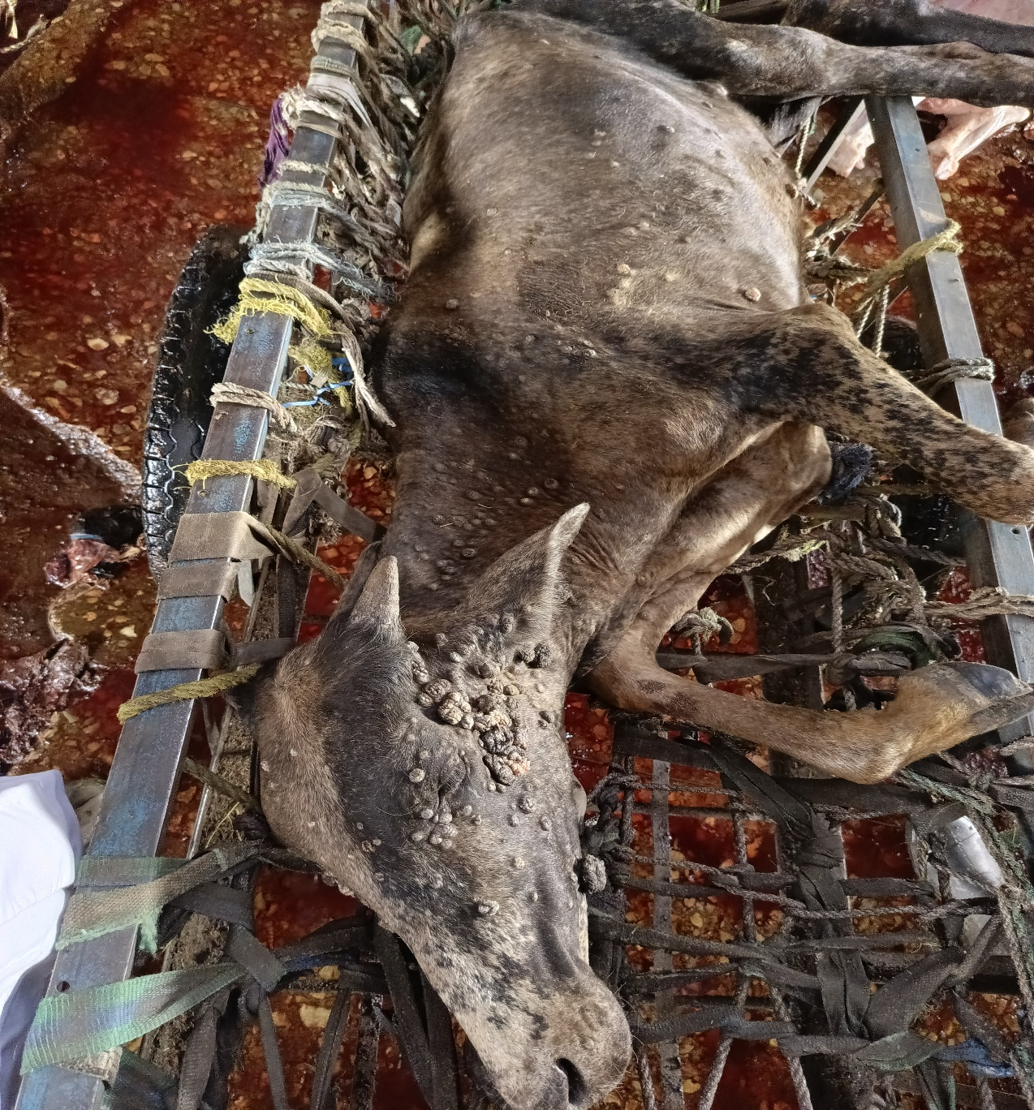
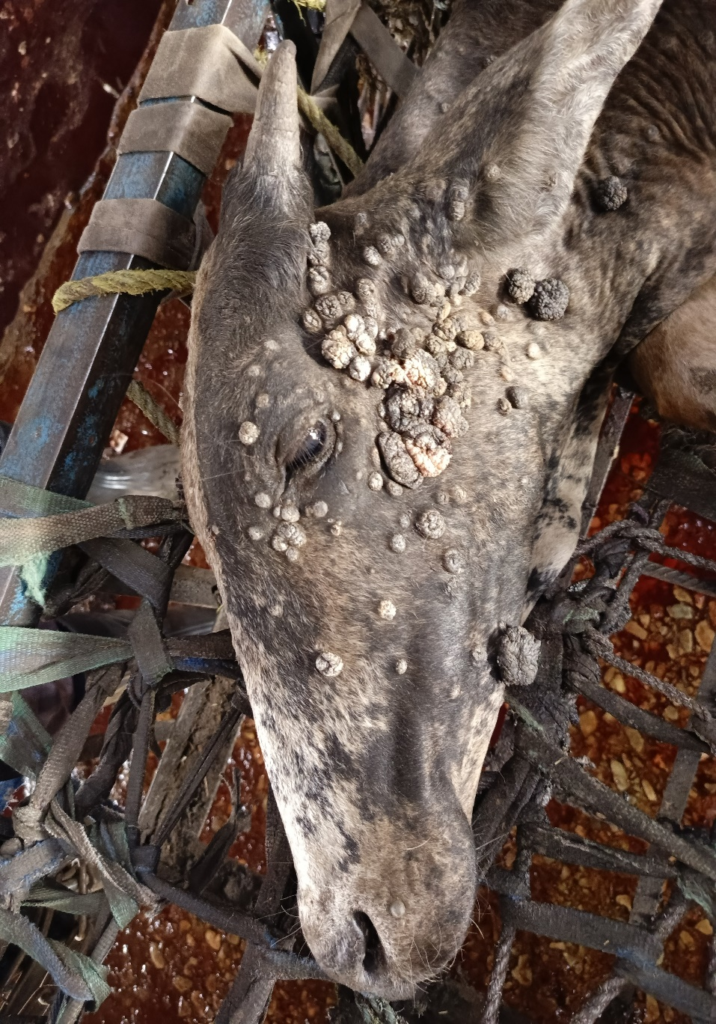
Should we slaughter this animal?

Slide 28
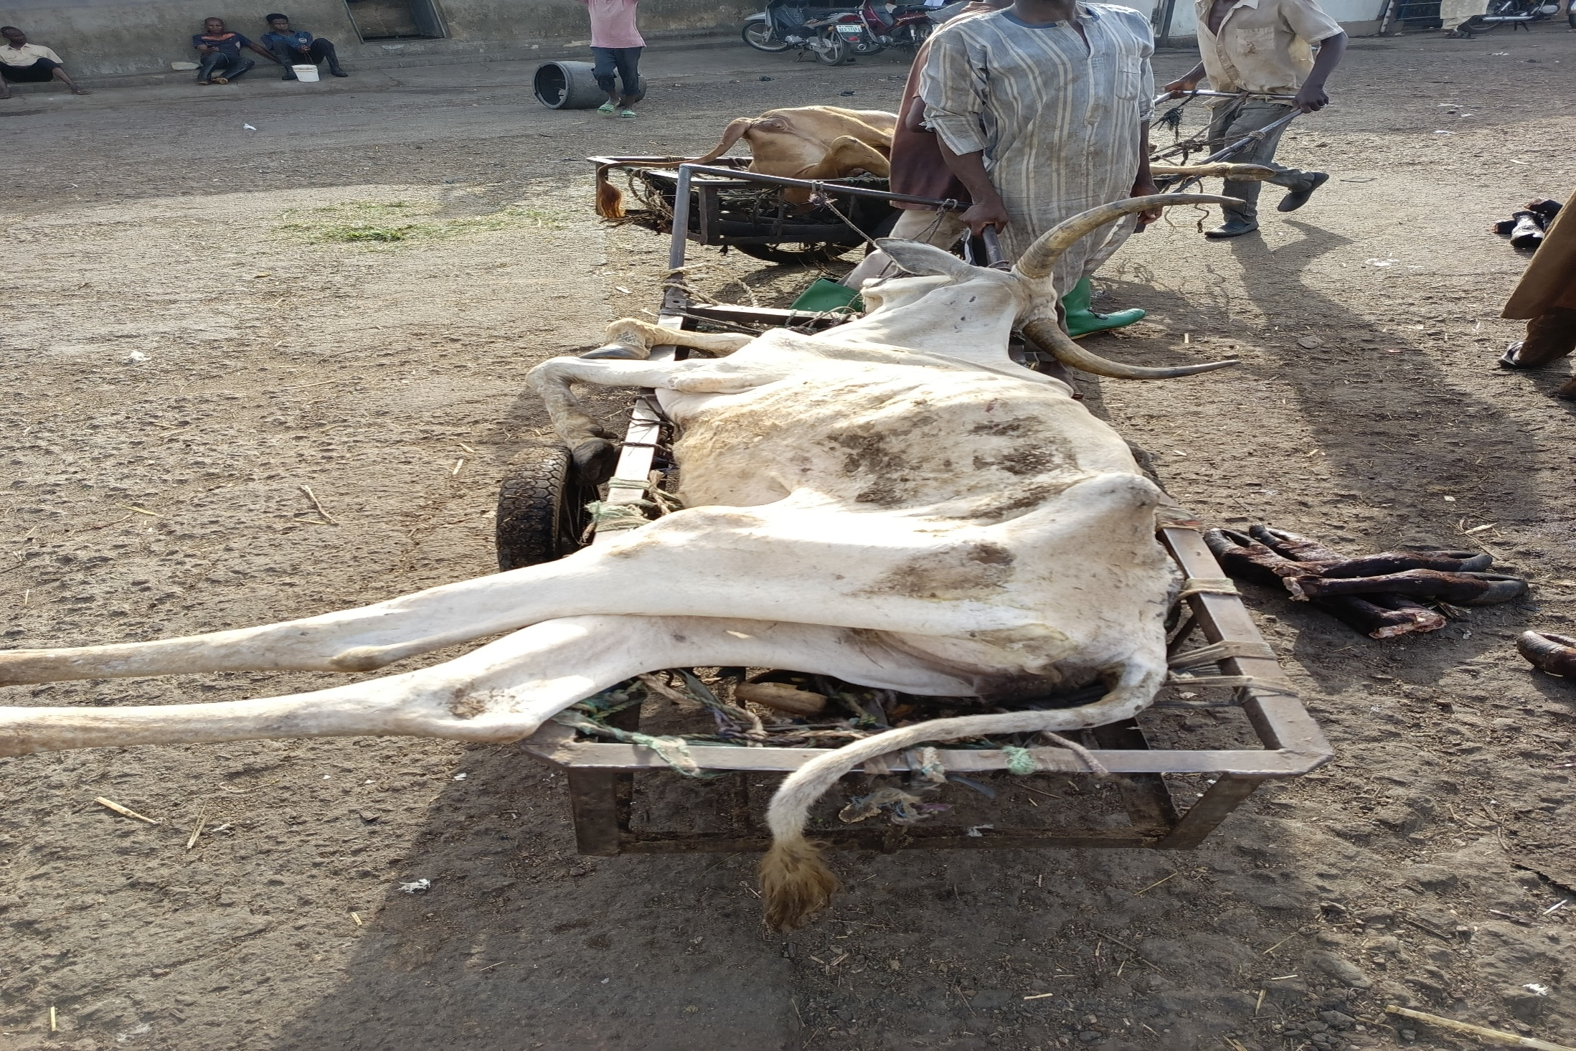
Should we slaughter this animal, also?

Slide 29
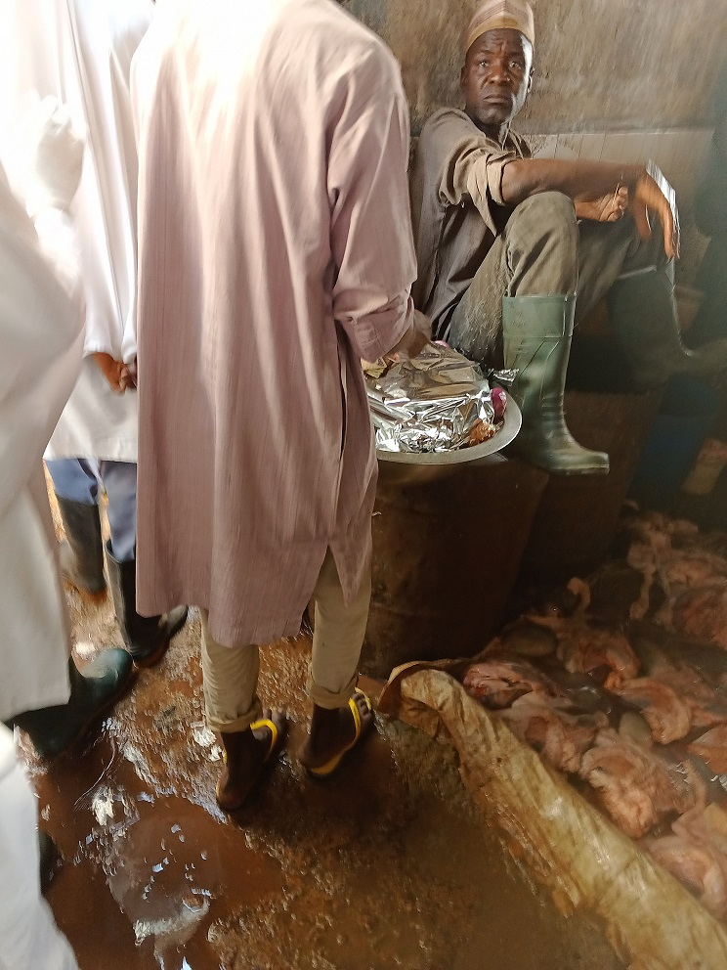
Eating suya at the tippery/guttery section while working on offals

Slide 30
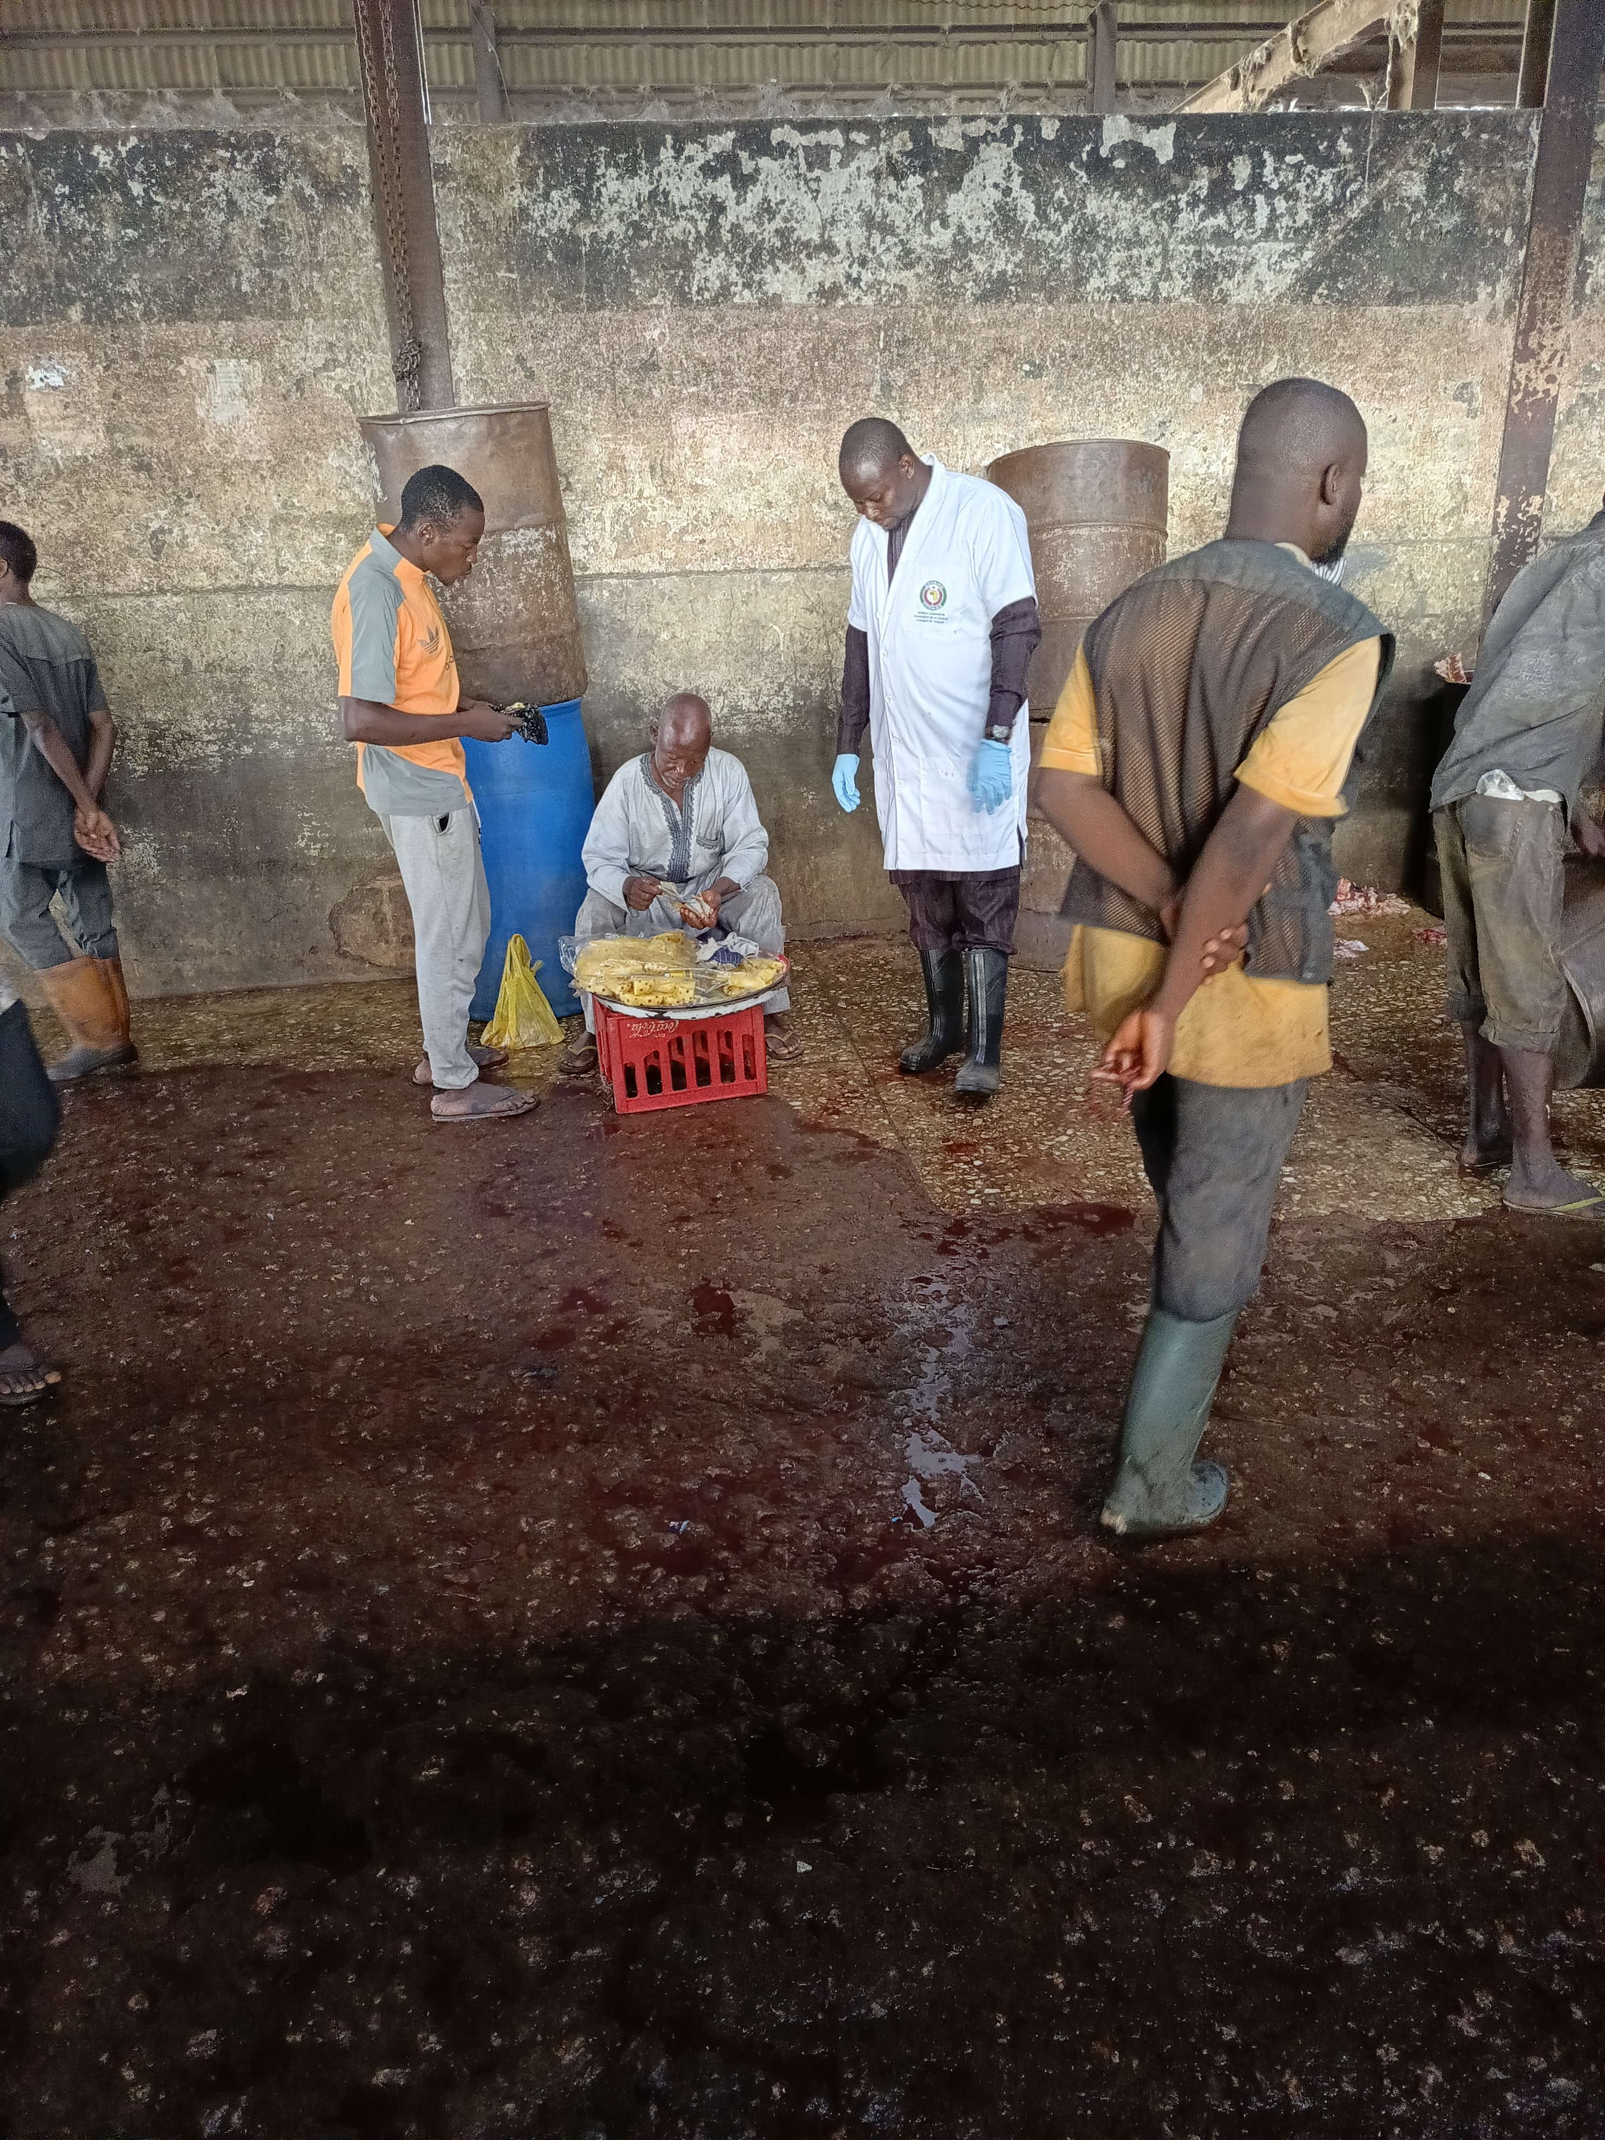
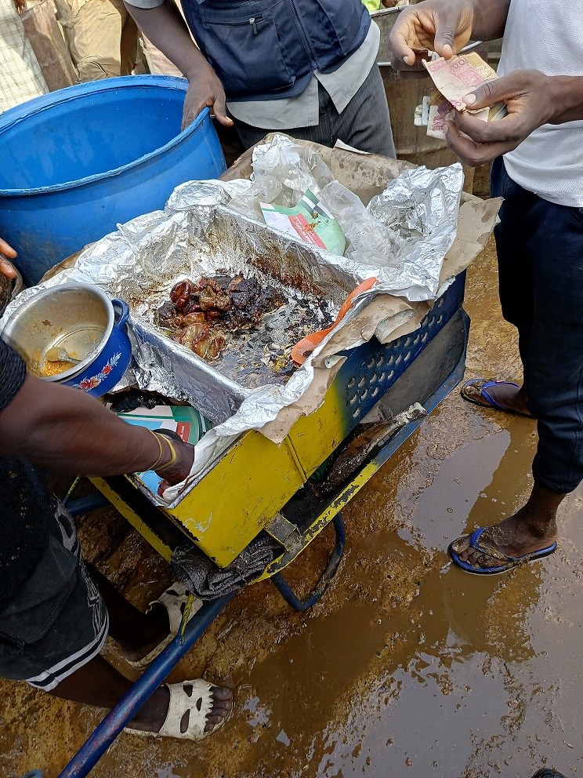
Pineapple & meat vendors inside abattoir halls

Slide 31
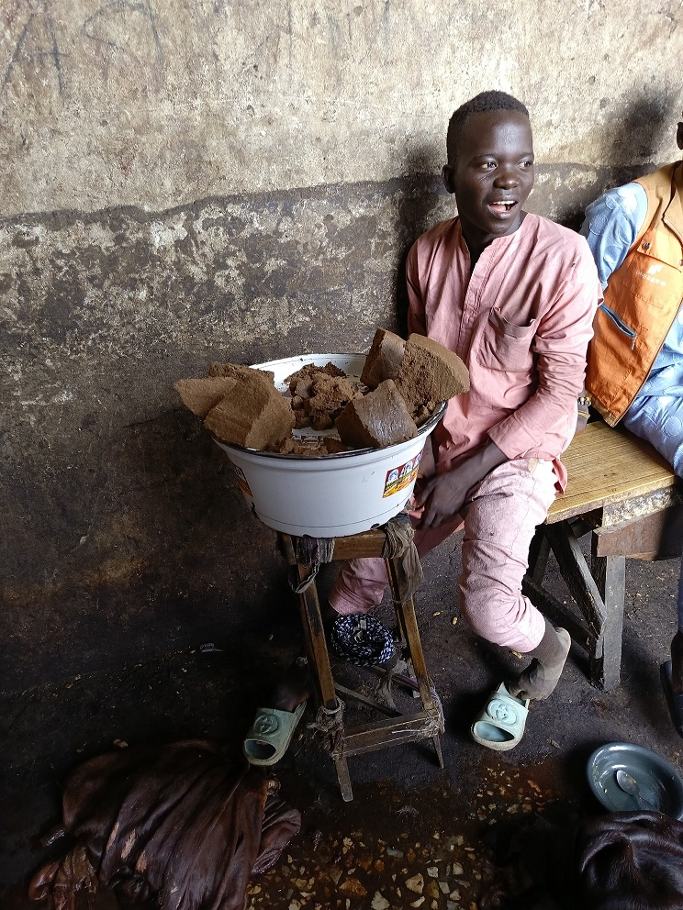
Food vendor inside slaughter hall

Slide 32
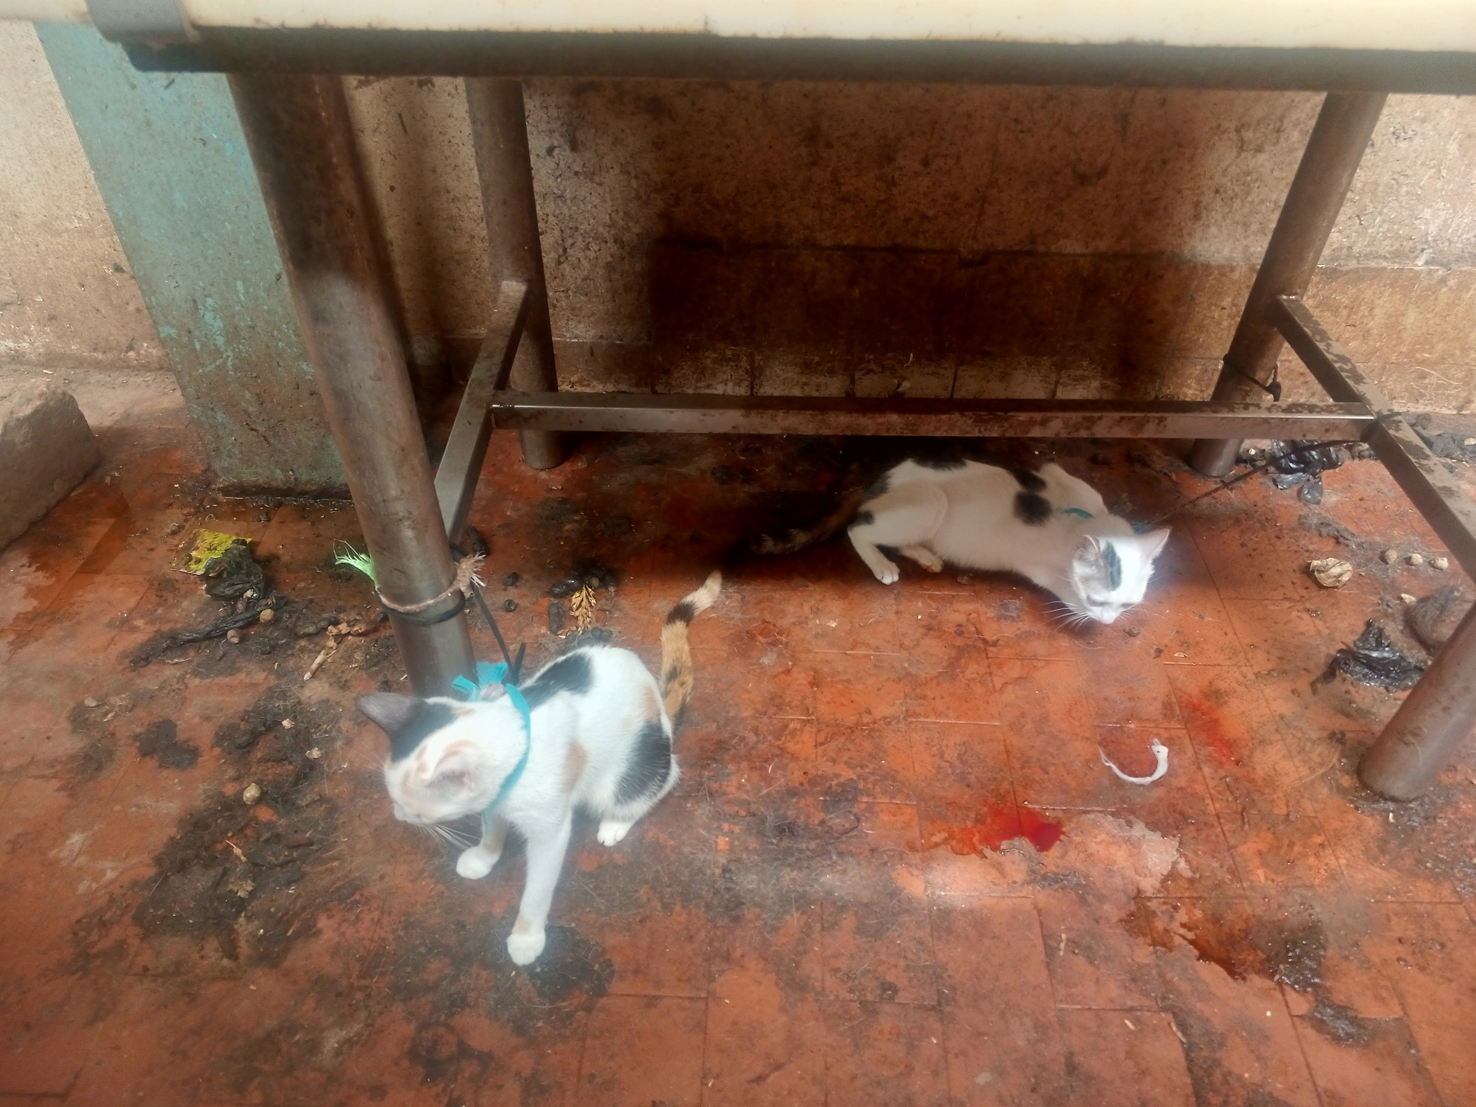
Cats reared inside slaughter hall and fed with raw offals

Slide 33
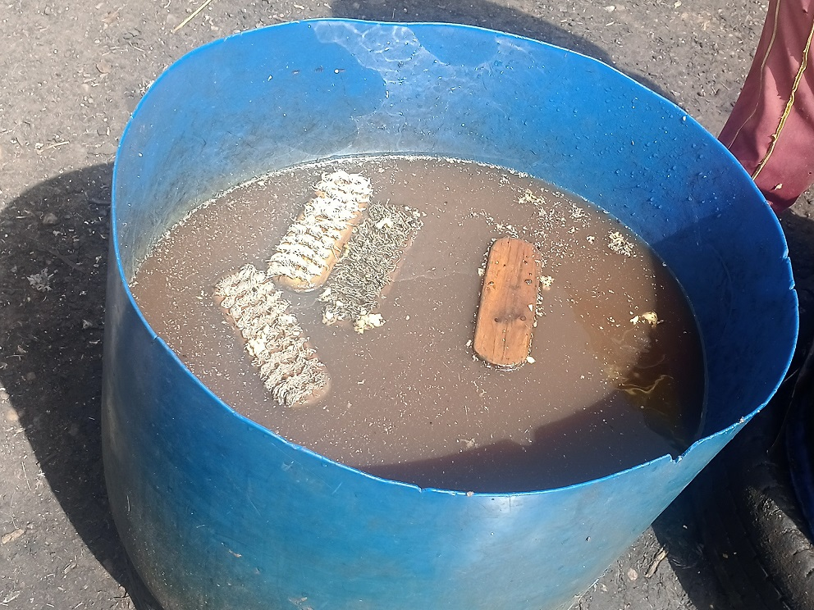
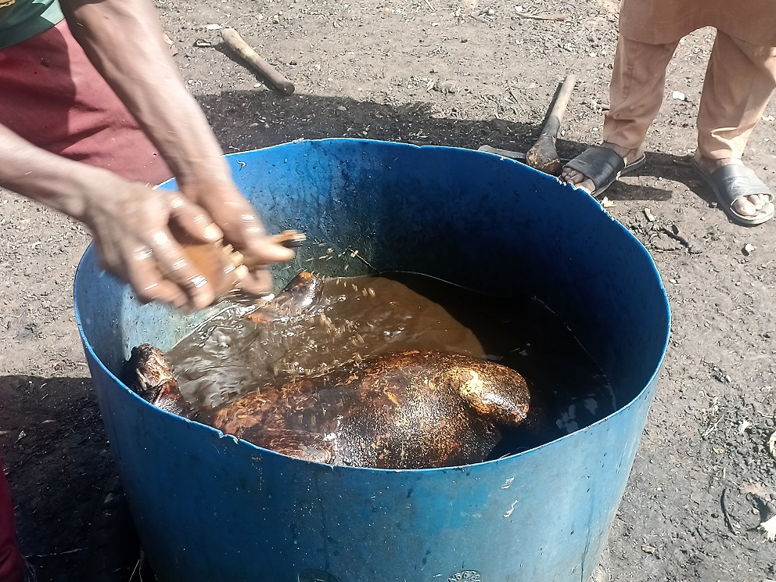
Type of water used in washing the head, limbs & skin after syngeing

Slide 34
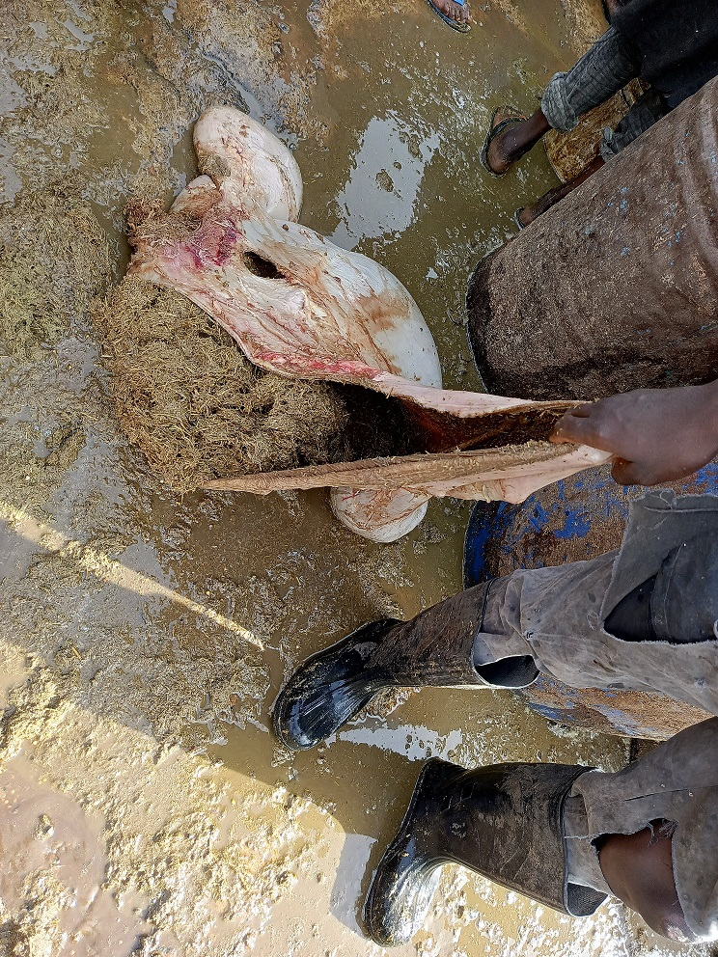
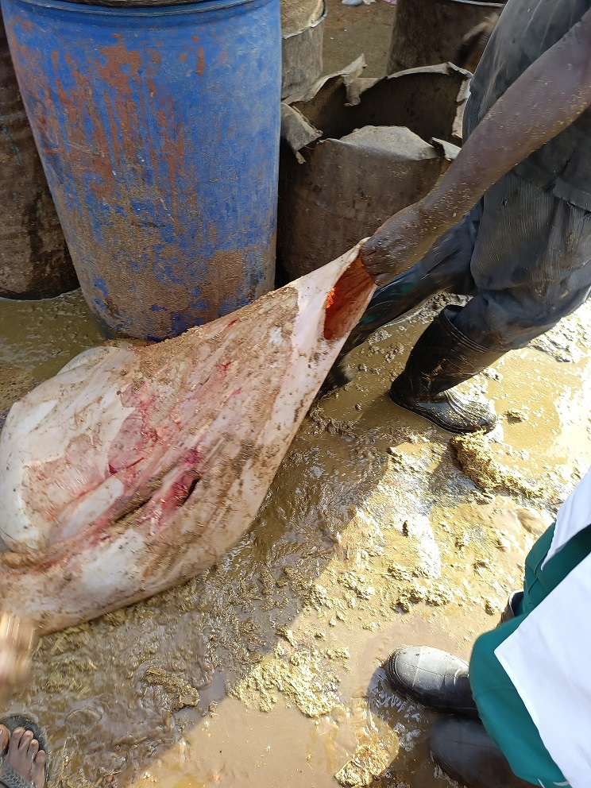
Dragging the rumen through abattoir effluents and dirts

Slide 35
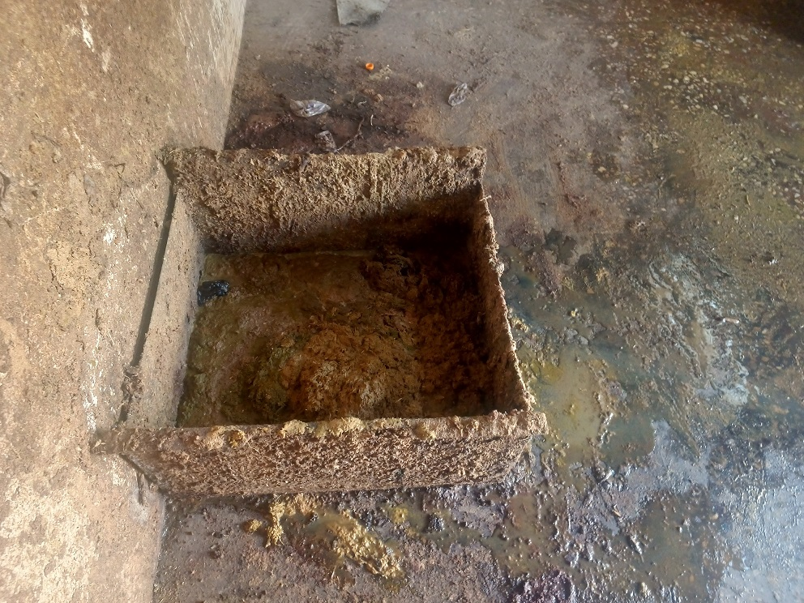
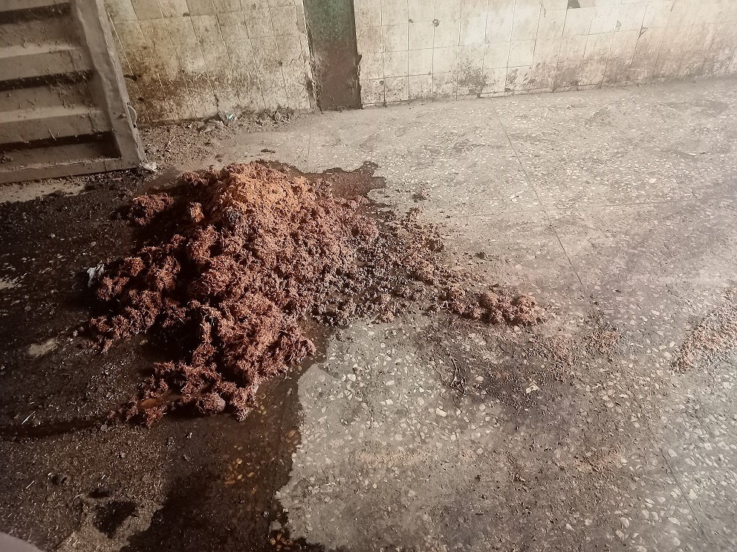
Dumping of ingesta inside the slaughter hall

Slide 36
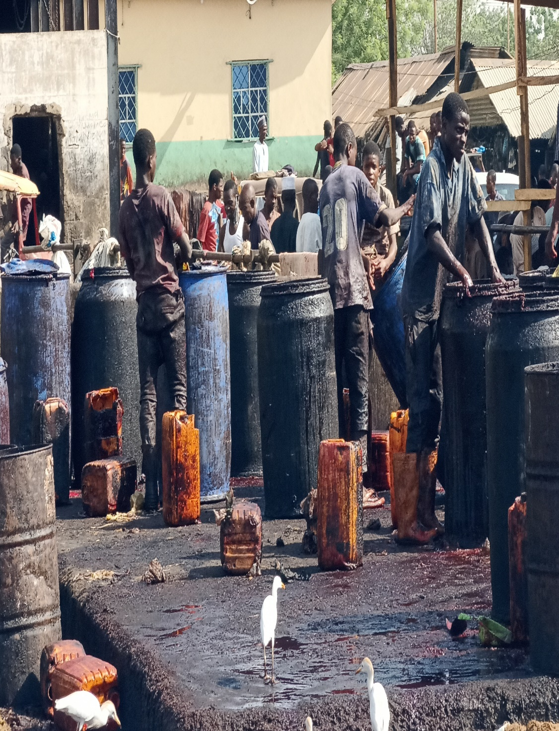
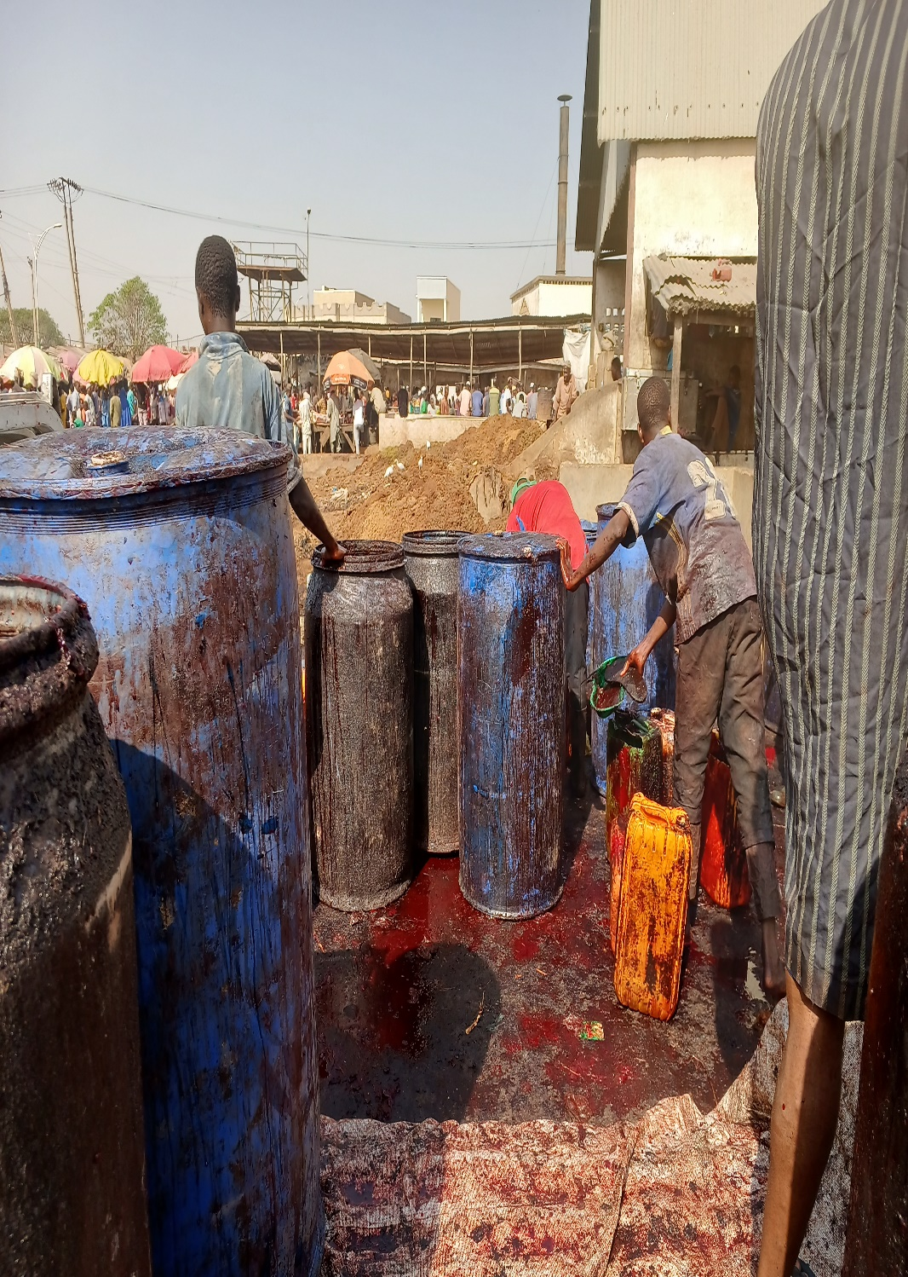
Blood collection center in Abattoir

Slide 37
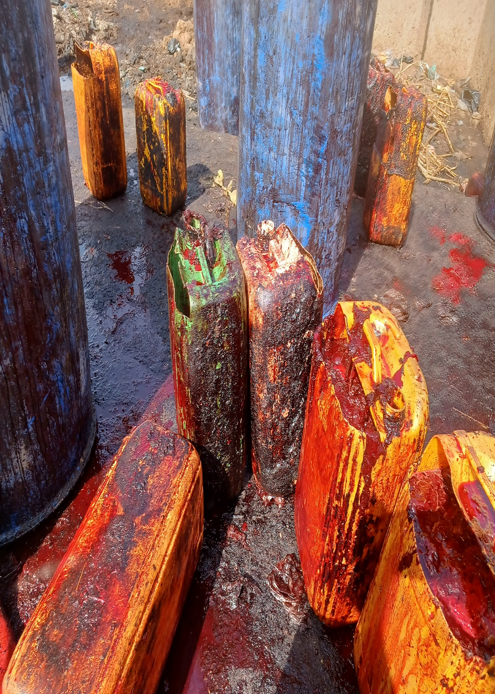
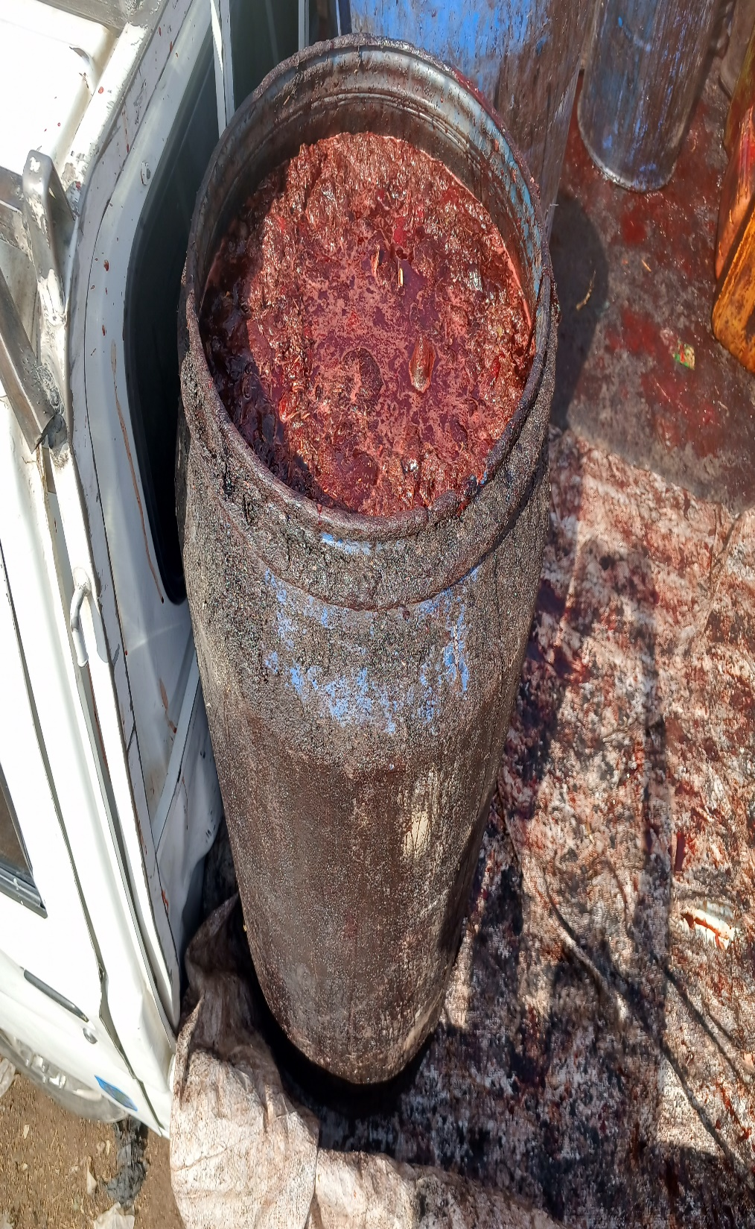

Slide 38
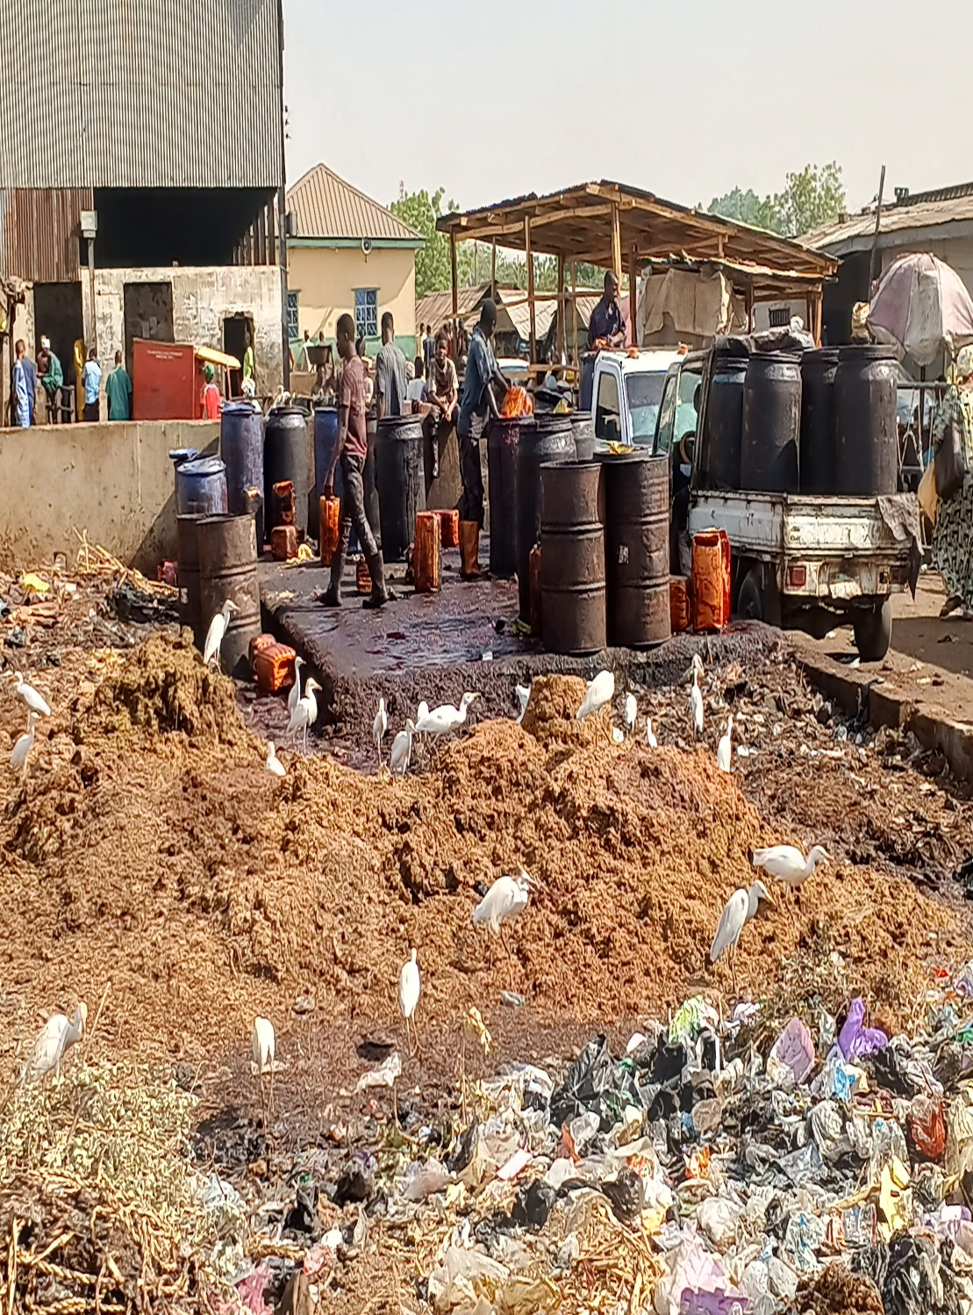
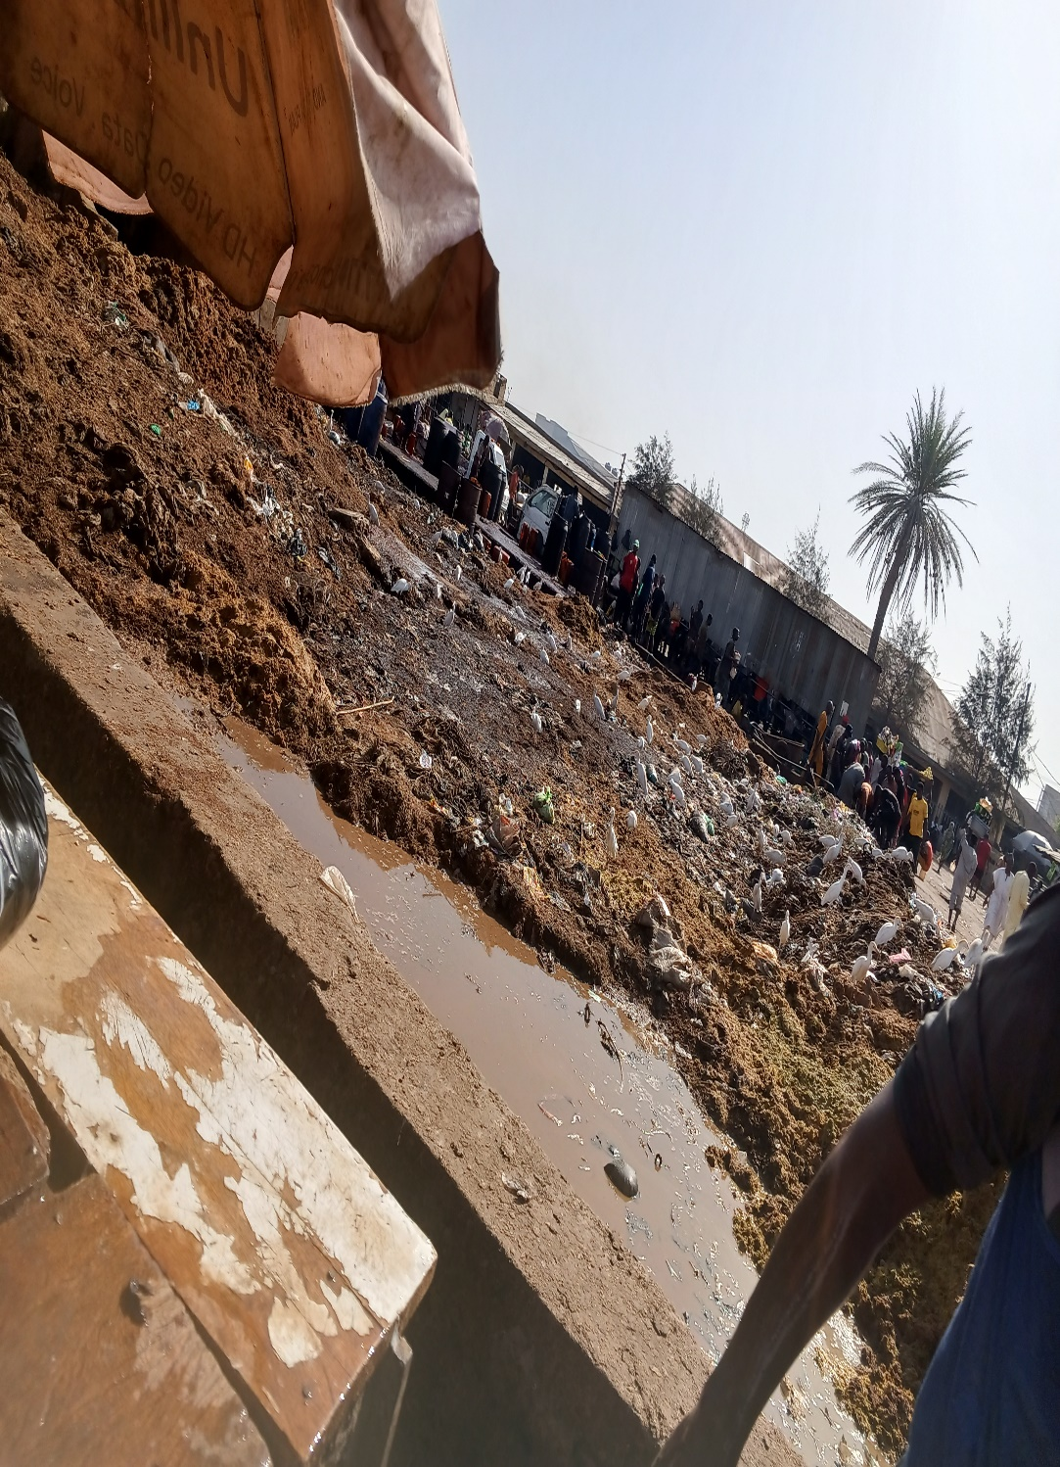
Fecal Waste Dump

Slide 39
How does the OH Team works in Abattoir?
Vets & AHWs: Conducts ante and post mortem inspections.
Public Health Officials: Monitor & investigate disease outbreaks among workers & environs.
Environmentalist: Assess waste mgt systems to ensure effluents are well disposed.
Microbiologist & Lab. Techs: Conducts biological testing on meat samples and others.
Policymakers & Community leaders: Create and enforce regulations for abattoir operations.

Slide 40
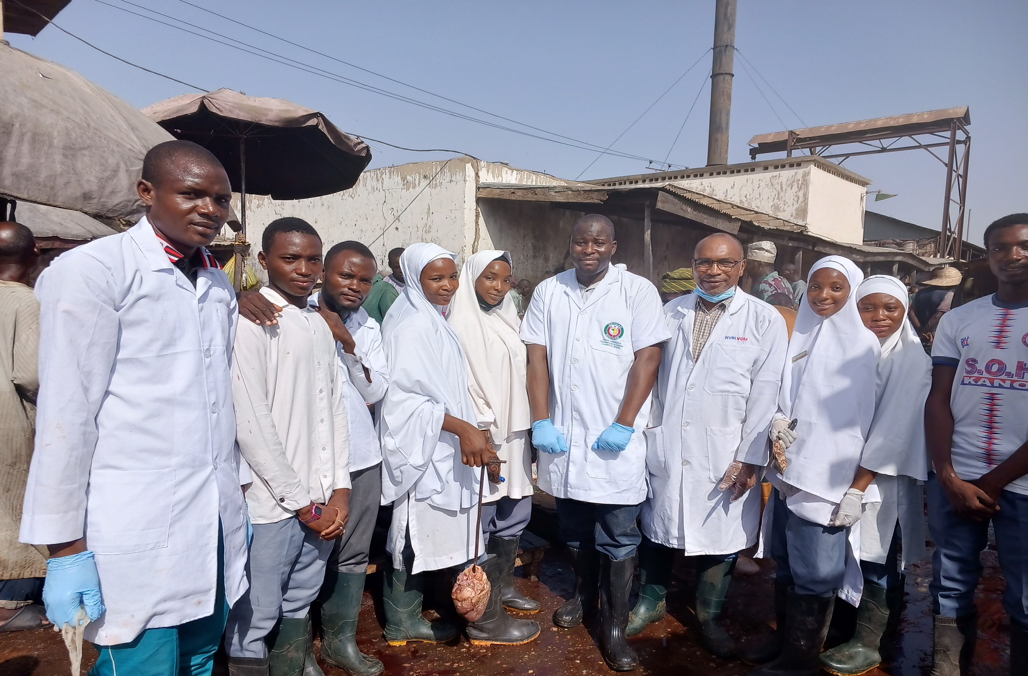
OH Team of Vets & CHEW Interns

Slide 41
Benefits of One Health in Abattoir
Zoonotic disease prevention.
Improved food safety.
Reduced antimicrobial resistance.
Enhanced environmental sustainability.
Increased awareness and education.

Slide 42
DISEASE TRANSMISSION ROUTES
DIRECT
Body fluids (urine, feces, blood, saliva, milk, semen)
Tissues (lesions, carcass)
INDIRECT
FOMITES (equipments; consumables; vehicles)
HUMAN
VECTOR
INSECTS (flies; ticks, fleas; lice)
Mother to off-spring
Breeding

Slide 43
DIRECT TRANSMISSION
FEED
DISCHARGE
BLOOD

Slide 44
INDIRECT TRANSMISSION
VEHICLES
HUMAN
SYRINGES, NEEDLES, DRENCHING GUNS;
BUCKETS; SHOVELS;

Slide 45
VECTORS
TICKS
FLEAS
FLIES

Slide 46
DISEASE IDENTIFICATION: RUMINANTS
POSTURE
BLOAT: Froathy bloat- water filled bag sound; gas bloat- drum sound.
CROSSED FORELIMB: Acute pain in medial claws; chest pain.
ABDUCTED HINDLIMBS: Acute pain in lateral claws; abdominal pain.
DIARRHEA: Nutritional; viral e.g. BVD, PPR or Orf; worms; bacterial e.g. clostridium, salmonella; Parasitic; coccidiosis.
NASAL DISCHARGE: Mucopurulent – bacterial or viral (PPR); watery- heat stress; foamy- poisoning.
OCULAR DISCHARGE: One eye- traumatic; both eyes- systemic; mucopurulent - bacterial.

Slide 47
DISEASE IDENTIFICATION: RUMINANTS
BODY LESIONS
SWOLLEN JAW (Worms; bacteria)
SKIN SCABS (Fungal like ringworm; mites infestation; Viral like LSD)
LUMPS (Viruses like LSD and Pox; bacterial abscesses)

Slide 48
VIRAL DISEASES OF RUMINANTS
LUMPY SKIN DISEASE: Nodular skin lesions, weakness, skin-horn separation, skin-hoof separation.
ORF: Papules, pustules and scabs covering ulcerations and granulations around the mouth.
FOOT AND MOUTH DISEASE: fever, profuse salivation, vesicles and ulcers in mouth and feet.
PPR (PESTE DES PETITS RUMINANT)
PAPPILOMATOSIS (solid outgrowths of epidermis)

Slide 49
BACTERIAL DISEASES OF RUMINANTS
PINK EYE: Lacrimation, eye twitching, photophobia, corneal opacity.
BRUCELLOSIS : Abortion epidemic, orchitis, hygroma.
TETANUS: General muscular rigidity, respiratory arrest, hyperesthesia.
MASTITIS: Reddish and painful; purulent discharge; bloody discharge.
CBPP (CONTAGIOUS BOVINE PLEUROPNEUMONIA):
Depression; coughing, expiratory grunting, arched back, marbling of lungs.
TUBERCULOSIS: Respiratory distress, stone like nodules on lungs and other parts.

Slide 50
PARASITIC DISEASES OF RUMINANT
INTESTINAL WORMS : Pallor, inapettance, bottle jaw, loss of weight.
LIVER FLUKES : Pallor, inapettance, bottle jaw, loss of weight.
LUNG-WORM : Coughing, fast heart rate, dyspnea.
TICK INFESTATION : Weakness, pale ocular mucous membrane, fever, paralysis.
FLEA INFESTATION : Itching, alopecia, reddened skin areas.
BITING FLIES : Pink eye, fly-irritation, restlessness.

Slide 51
METABOLIC DISEASES OF RUMINANTS
MILK FEVER (Inappetance, recumbency, ruminal stasis and boat, dry muzzle, scant feces, weak pulse, coma and death)
GRASS TETANY (Incoordination, muscular spasms and convulsions, hyperesthesia)
PICA APPETITE

Slide 52
VIRAL DISEASES OF POULTRY
Newcastle Disease Symptoms
Greenish stool
Torticollis
Gumboro Disease Symptoms
Catching cold posture
Blood spots on muscles
Somnolence (Sleeping posture)
Pox Disease Symptoms
Dry pox lesions
Wet pox lesions
Marek's Disease Symptoms Hurdle jumper position Small pupils Paralysis

Slide 53
BACTERIAL & PARASITIC DISEASES OF POULTRY
BACTERIAL
COLLIBACILLOSIS
Yellowish white covering of liver
Paralysis
FOWL CHOLERA
Swollen madibular region
Swollen wattles
Coryza
Swollen eye lid
Drooling saliva
Swollen eyelids
PARASITIC COCCIDIOSIS Blood filled ceca Blood stained stool Bloody faeces WORMS Gape worms: chicken gasping for air Round worms live in intestine eating digested food Intestinal worms at postmortem LOUSINESS

Slide 54
SIGNS OF HEAT STRESS IN POULTRY
Heat stressed broiler cock
Signs of heat stress

Slide 55
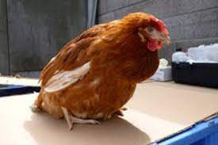
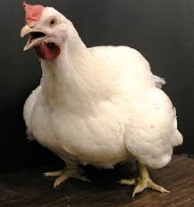
DISEASE IDENTIFICATION: POULTRY
POSTURE
SOMNOLENCE
TORTICOLLIS
PARALYSIS
PENGUINE POSTURE
HEAT STRESS

Slide 56
DISEASE IDENTIFICATION: POULTRY
DISCHARGE
Bloody stool
Greenish stool
White diarrhea
BODY LESIONS
Pox
Bluish discoloration
Swollen face

Slide 57
EGG SIGNS OF DISEASE/CONDITION
Soft shell eggs
-Calcium deficiency
Blood stained eggs
-Vent prolapse
-Internal bleeding
Shell-less egg
-New laying hen
Corrugated eggs -Poor nutrition -Heat stress -Salty water Sand-like particles on egg -Any stress during egg calcification Misshaped eggs -Diseases e.g. NCD, AI -Stress

Slide 58
LIVESTOCK BIOSECURITY
(CONCEPTUAL)
Away from highways
Well shaded trees
Well spaced pens

Slide 59
LIVESTOCK BIOSECURITY
(STRUCTURAL)
Fencing
Isolation centre
Proper feed storage

Slide 60
LIVESTOCK BIOSECURITY
(STRUCTURAL)
Efficient waste management
Quarantine area
(at least 14 days)
Incoming vehicle disinfection point

Slide 61
LIVESTOCK BIOSECURITY
(OPERATIONAL)
Visitors login book
Foot-bath area
Pen disinfection

Slide 62


Thank you

